Slide 1

Exploratory Data Analysis: Key Indicators of Heart Disease
Presented by: Joyce Chan

Slide 2
Background
Heart disease: a term that refers to several types of heart conditions, most commonly ‘coronary artery disease’ which affects blood flow to the heart and can present itself as angina or a heart attack
Leading cause of death in the US
Half of all Americans have at least 1 major risk factor for heart disease
Lifestyle choices (healthy diet, physical activity) can greatly mitigate the risks for heart disease
This analysis will be taking a closer look at key indicators of heart disease
Notes:
First of all, what is heart disease? The term “heart disease” refers to several types of heart conditions. The most common type of heart disease in the United States is coronary artery disease (CAD), which affects the blood flow to the heart and can present itself as angina or a heart attack.
According to the CDC, heart disease is a leading cause of death in the US. About half of all Americans have at least 1 major risk factor for heart disease. There are numerous key indicators that have varying levels of impact on the likelihood of developing heart disease. Identifying and preventing the factors that have the greatest impact is hugely important in healthcare. I firmly believe that non-medicinal preventative methods can do as much as preventative medicine for mitigating heart disease risk. Lifestyle choices such as eating healthier foods, getting more physical activity, smoking less are choices that every adult can make daily to prevent their likelihood of heart disease and it is important to recognize which choices are most important.
We can greatly improve the US healthcare system, reduce healthcare costs, lower prevalence of heart disease in the country if more people were aware of key indicators of heart disease and ways to minimize their risks. For my final project I decided to investigate risk factors for developing heart disease.

Slide 3
The dataset
This dataset is originally from the CDC
Data is compiled from a 2022 telephone survey that collected data on the health of more than 400,000 US residents each year
Data was filtered by a third party on Kaggle to focus on health disease and its associated indicators
Contains 40 columns and 445,132 rows
Categorical variables (such as YES/NO values for ‘HadAsthma’, ‘HadSkinCancer’, and many more)
Numerical variables (such as ‘SleepHours’, ‘BMI’, and more)
Notes:
I am using a dataset found on Kaggle.com. The dataset originally comes from the CDC and contains data from annual telephone surveys that collect data on the health of more than 400,000 US residents each year. The dataset I'm using contains data from 2022, and it was filtered on Kaggle by the user who posted the dataset to focus on health disease and its associated indicators. There are 40 columns and over 445 thousand rows with categorical variables such as yes/no answers for ‘HadAsthma’, ‘HadSkinCancer’, and more. There are numerical variables such as values for Sleep hours and BMI.

Slide 4

hypotheses
A person's general health will have a high negative correlation with heart disease prevalence. General health is a risk factor of heart disease.
Those with heart disease do not have a higher average BMI than those without heart disease.
Those with heart disease are not older on average than those without heart disease.
Notes:
The hypotheses that I will be working with througout this analysis are:
Decline in general health will have a high correlation with heart disease prevalence. General health is a risk factor of heart disease.
Those with heart disease do not have a higher average BMI than those without heart disease. (and just to explain, BMI stands for body mass index and is calculated using a person’s weight and height. The higher the BMI is, the higher the body weight)
Those with heart disease are not older on average than those without heart disease.

Slide 5

method
Data cleaning:
Imported dataset from Kaggle into Jupyter notebook
Removed duplicates and rows with empty null data
Combined ‘HadAngina’ and ‘HadHeartAttack’ columns into one column called ‘HadHD’
Changed categorical values like ‘YES’ and ‘NO’ to 1 and 0
Changed categorical values for ‘GeneralHealth’ and ‘AgeCategory’ into numerical values and created new columns ‘GeneralHealthNumbers’ and ‘AgeCategoryNumbers’
Notes:
As for how I approached this analysis, my method began with data cleaning. I imported the dataset into a Jupyter notebook, removed duplicates and rows with empty data. I made a new column called ‘HadHD’ which indicates whether the individual had heart disease or not and I combined the 2 columns ‘hadangina’ and ‘hadheartattack’ since either of these indicate the presence of heart disease.
I also had to change many categorical values like ‘yes/no’ into 1 and 0 so I can use these columns in my statistical analysis.
The column for general health had 5 different categorical values: ‘excellent’, very good, good, fair, and poor. I changed these values into a rating scale from 1-5 instead, 5 being excellent, 1 being poor.
Similarly for age category, the survey was conducted with age categories like 24-29, 30-34, 35-39, and so on. So instead of having these categories, I assigned a number value from 1-13 for each of the categories to make them easier to work with for our statistical tests.

Slide 6
method
2. Exploratory data analysis: used Numpy, Pandas, MatPlotLib, Seaborn, Scipy to analyze and visualize the data
3. Hypothesis testing: used Pearson correlation test and two-tailed t-tests to look for statistical significance
Notes:
After cleaning the data, I did some exploratory data analysis using various python libraries to analyze and visualize the data.
And then I did statistical tests for my hypotheses. I used the Pearson correlation test to determine if GeneralHealth has a correlation with heart disease, as well as two-tailed t-tests to look for a statistically significant difference in average BMIs and average age categories of people with and without heart disease

Slide 7
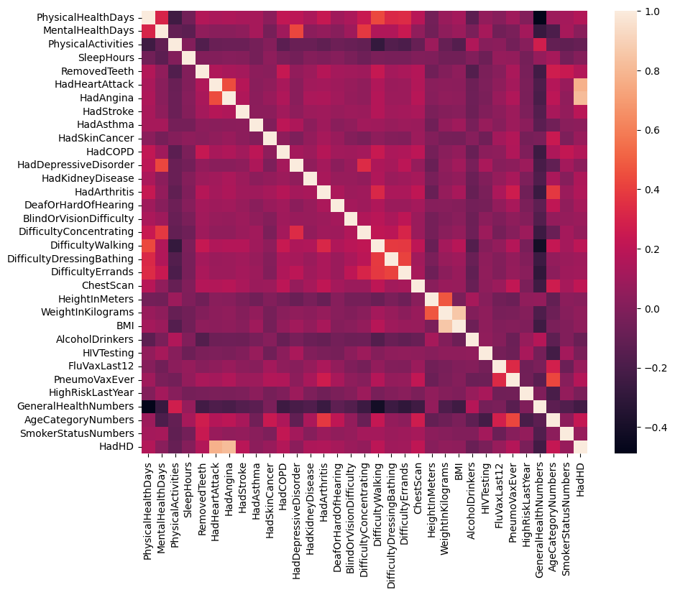
Correlation heat map
Notes:
I created a correlation heat map to show visually the relationships different variables have with each other. This is interesting to look at and analyze if you wanted to closely examine certain variables and their relationships. But for the purposes of this analysis I’m going to hone in on just the correlations of variables with heart disease.

Slide 8
Correlations with heart disease
Risk Factor | Correlation
AgeCategoryNumbers | 0.228816
GeneralHealthNumbers | -0.228229
ChestScan | 0.214651
DifficultyWalking | 0.199102
HadStroke | 0.189611
PneumoVaxEver | 0.168544
HadCOPD | 0.168160
RemovedTeeth | 0.166556
PhysicalHealthDays | 0.164675
HadArthritis | 0.162284
HadKidneyDisease | 0.148357
DeafOrHardOfHearing | 0.125195
DifficultyErrands | 0.107830
DifficultyDressingBathing | 0.101095
PhysicalActivities | -0.095871
AlcoholDrinkers | -0.084421
BlindOrVisionDifficulty | 0.084224
HadSkinCancer | 0.080344
FluVaxLast12 | 0.074775
SmokerStatusNumbers | 0.074012
DifficultyConcentrating | 0.060684
WeightInKilograms | 0.050380
BMI | 0.044997
Age category and general health have the highest correlation with prevalence of heart disease
We can come up with many different hypotheses based on these correlations
Comorbidities (ie. Having arthritis, kidney disease, COPD) increase risk of heart disease
Difficulty with hearing or vision, difficulty doing errands, walking, dressing, bathing signify advanced age or presence of comorbidities, and therefore is associated with heart disease
Notes:
On the right here is a table that shows the variables with the highest correlation coefficients with heart disease.
Age Category and General Health appear to be the variables with the highest correlations so this tells us that heart disease is associated with an increase in age, and a decline in general health.
Going down the list, there are other variables like history of chest scan, difficulty walking, history of stroke.
We can come up with many different hypotheses based on these correlations such as having comorbidities can increase risk of heart disease.
If I had more time to spend on this project I would test these hypotheses as well, and I would look at correlations of grouped variables with heart disease.
Unlike other statistical tests in which correlation coefficients are very high and there are strong linear relationships between factors and outcomes, in healthcare it is important to recognize that likelihood of developing a disease comes from many existing factors compounded together. Just because somebody is overweight does not mean they will certainly develop heart disease, but their weight may still slightly increase the risk. When looking at risk factors individually, there might not appear to be a very strong correlation based on the calculated coefficient, but it is important to minimize every risk factor where we can.

Slide 9
Hypothesis testing 1
Hypothesis 1: Decline in general health will have a high correlation with heart disease prevalence. General health is a risk factor of heart disease.
To test this hypothesis, I used a Pearson correlation test on the ‘GeneralHealthNumbers’ column and the ‘HadHD’ column
Correlation coefficient = -0.23
P-value = <0.05
Since this is a relatively high coefficient value and since the p-value is close to 0 (and therefore statistically significant), general health appears to be a statistically significant correlation to heart disease prevalence.
Conclusion: Heart disease has a weak but statistically significant correlation with a decline in general health.
Notes:
My first hypothesis was that a decline in general health will have a correlation with heart disease. To test this, I used a Pearson correlation test on the columns for GeneralHealth and heart disease. The correlation coefficient came out to be -0.23 and the p-value was less than 0.05 meaning it was significant.
Since this is a relatively high coefficient in the context of health, and since the p-value is close to 0, general health is a statistically significant correlation to presence of heart disease. So heart disease has a weak but statistically significant correlation with a decline in general health. And the hypothesis is proven correct.

Slide 10
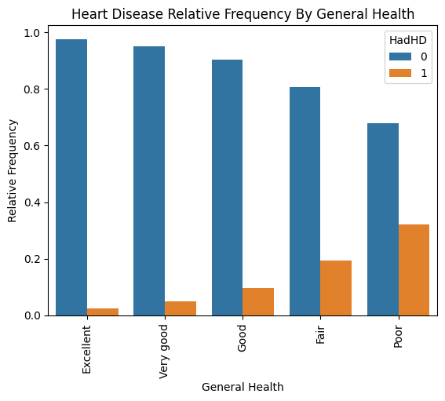
There is a clear increase in relative frequency of heart disease as the general health declines from ‘excellent’ to ‘poor’.
Notes:
As you can see from this bar plot, the relative frequency of people with heart disease compared to those without heart disease goes up as general health goes down from ‘excellent’ to ‘poor’.

Slide 11

Hypothesis testing 2
Hypothesis 2: Those with heart disease do not have a higher average BMI than those without heart disease.
Sample 1: mean BMI of people with heart disease is 29.6
Sample 2: mean BMI of people without heart disease is 28.6
T-test results: p-value = <0.05
Confidence interval: with 95% confidence, there is a difference of between 0.94 and 1.13 in the average BMI when comparing those with heart disease and those without.
Conclusion: We can reject the null hypothesis. The average BMI changes significantly depending on whether heart disease is prevalent or not. It is higher when heart disease is prevalent.
Notes:
The second hypothesis I had was that people with heart disease do NOT have a higher BMI on average than those with heart disease.
To test this I used a two-tailed t-test.
I split up the population into 2 samples. Sample 1 was people with heart disease, and I calculated their mean BMI to be 29.6. Sample 2 was people without heart disease, and their mean BMI is 28.6
The t-test resulted in a p-value of much less than 0.05 meaning there is a significant difference between the 2 means at a 95% confidence level.
Through my analysis, we can REJECT the null hypothesis. In simple terms, the mean BMI changes significantly depending on whether heart disease is present or not. BMI is higher on average when heart disease is present so we can say that BMI is a risk factor for heart disease.

Slide 12
Hypothesis testing 3
Hypothesis 3: Those with heart disease do not have a higher average age category than those without heart disease.
Sample 1: average age category of people with heart disease is 10.3 (ages 65-69)
Sample 2: average age category of people without heart disease is 7.5 (ages 50-54)
T-test results: p-value = <0.05
Confidence interval: with 95% confidence, there is a difference of between 2.77 and 2.84 in the average age category when comparing those with heart disease and those without.
Conclusion: We can reject the null hypothesis. The average age changes significantly depending on whether heart disease is prevalent or not. It is higher when heart disease is prevalent.
Notes:
The second hypothesis I had was that people with heart disease are NOT older on average than those with heart disease.
To test this I used a two-tailed t-test.
I split up the population into 2 samples. Sample 1 was people with heart disease, and their mean age category was 10.3 (which equates to ages 65-69). Sample 2 was people without heart disease, and their mean age category was 7.5 (which equates to the age range of 50-54)
The t-test resulted in a p-value of much less than 0.05 meaning there is a significant difference between the 2 means. At a 95% confidence level, there is a difference of about 2.8 in mean age category which translates to about 14 years of age.
Therefore we can REJECT the null hypothesis. Heart disease is associated with a higher age so we can say that increasing age is a risk factor for heart disease.

Slide 13
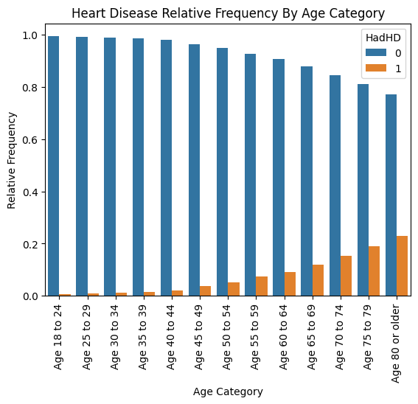
There is a clear increase in relative frequency of heart disease as the age category increases
Notes:
From this bar plot, you can see that the relative frequency of people with heart disease compared to those without heart disease goes up as the age category increases with the highest relative frequency of heart disease existing for people in the age 80 or older bracket.

Slide 14

conclusion
Through this analysis, I was able to come to three main conclusions:
General health is a significant risk factor of heart disease and has an inverse correlation with heart disease prevalence
Those with heart disease have a statistically significant higher average BMI than those without (null hypothesis rejected)
Those with heart disease are on average older than those without heart disease (null hypothesis rejected)
Simply put: general health decline, BMI, and older age are risk factors of heart disease.
Many further hypotheses can be studied through analyzing this dataset and can prove to be extremely valuable to the general population as well as healthcare providers and insurance companies.
As I continually improve my expertise in data analytics, I will aim to uncover more healthcare insights through patterns in data.
Notes:
Through this analysis, I was able to come to three main conclusions.
First, decline in general health is a risk factor of heart disease.
Second, higher BMI is associated with heart disease so BMI is a risk factor.
Third, increased age is a risk factor of heart disease since heart disease is associated with older age.
This is a really great dataset and many more hypotheses can be studied through analyzing it. Many sectors of the population will find my findings valuable such as healthcare providers, insurance companies, as well as the general population. Healthcare providers will be able to better advise on healthy lifestyle choices and ways to prevent heart disease. Insurance companies can use the findings to be aware of what key indicators to screen for when offering certain types of insurance such as life insurance and health insurance. The general population, particularly older adults, will be better informed on their own health and risks.
As I continually improve my expertise in this field, I will aim to continually uncover valuable healthcare insights through patterns in data.

